Slide 1
Package ggmap, maps
Simple plot of Daily Crime Rate-ggplot2
Heatmap of Crime Rate by Time-maps, ggplot2
Heatmap of Crime Rate by Location-ggmap, ggplot2
Huanou Liu
FE- 515B Fall 2016

Slide 2
Crime Rate by Time-ggmap
Funtion #1: geocode(), ggmap()
#Translate an address (string) to a point in longitude, and latitude
For example:
New ST and Ocean Ave, Jersey City, NJ → (-74.07646, 40.70572)
LatLon <- c(apply(place, 1, geocode))
#geocode() cannot be applied on dataframe object, so it runs like a loop by calling apply()
Function #2: png(), ggplot2()
png(filename = 'dailyCrimes.png', width = 800, height = 600, units = 'px')
# First, create a png file directly, units="px", pixel
ggplot(dailyCrimes, aes(x = Hour, y = Freq)) + geom_line(aes(group = Day, color = Day)) + xlab('Hour') + ylab('Number of crimes') + ggtitle('Daily number of crimes')dev.off()
# Then, we plot in that png file by using ggpplot2

Slide 3
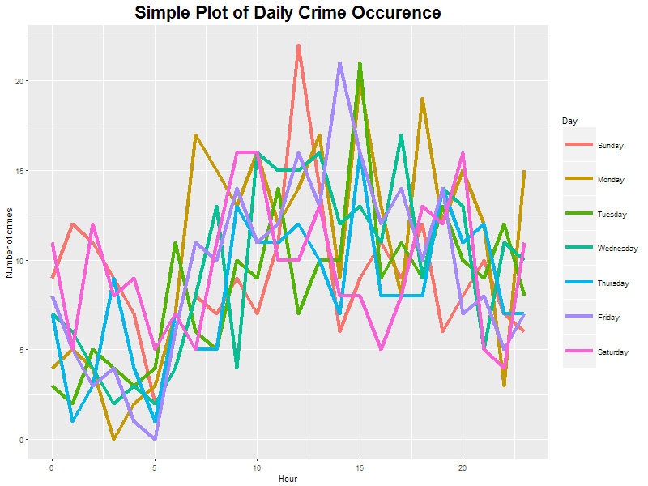
1836 Observations by Time
This presentation is not perfect, we cannot catch the data information directly
So, we can generate a better one- a heatmap by using package “maps” and “ggmaps”

Slide 4
Function #3: geom_tile() in ggplot2 #plot in squares(tiles), by using the center of the tile and its size(x, y, width, height)
For example: geom_tile(aes(fill = Freq)) + scale_fill_gradient(name = 'Total Crimes', low = 'green', high = 'red') +, plot.background = element_rect(fill = 'white', color = 'white')
Function #4: get_map() in maps
For Example, jc <- get_map(location = "jersey city", zoom = 13)
Function #5: ggmap()plots the raster object produced from get_map , scale_x_continuous(), scale_y_continous()
For example: ggmap(jc) + scale_x_continuous( limits = c( -74.12 , -74.02 ) , + scale_y_continuous( limits = c( 40.675 , 40.75 ) #By xlim, ylim to set the range of jersey city on Google map. Plot a location heatmap

Slide 5
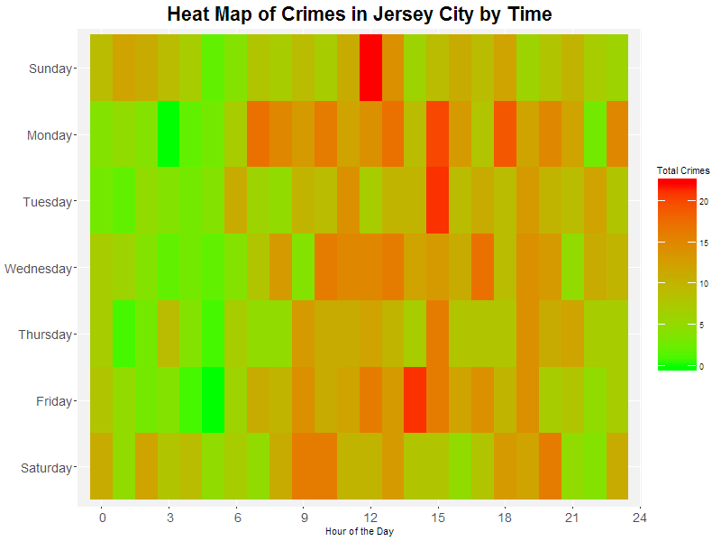

Slide 6
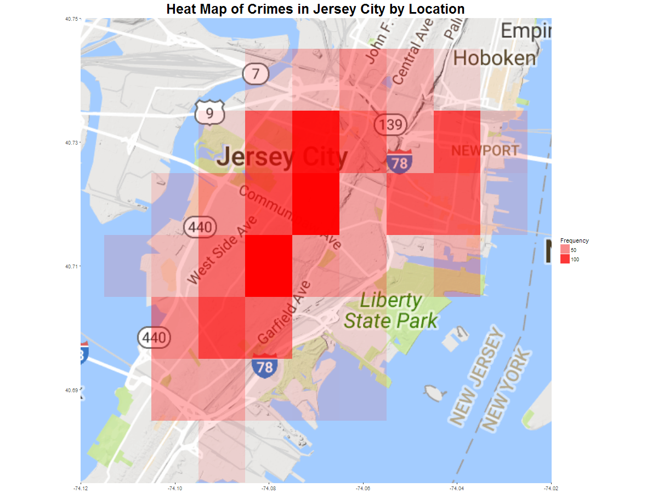

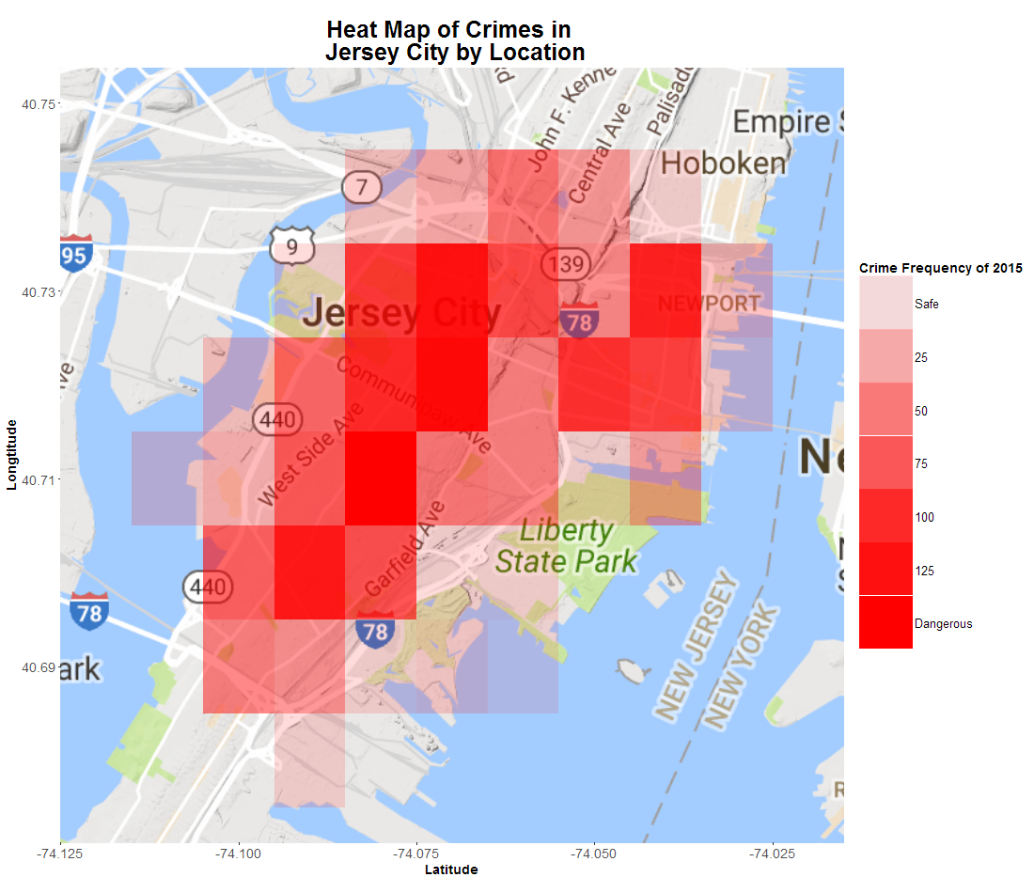

Slide 7
Thank you !
Data Source: www.data.jerseycitynj.gov
www.maps.google.apis.com

